Slide 1


Lightning Talk
Requirements & Engineering Standards

Slide 2
Team: sdmay21-51
Logan Anderson: Senior, Computer Engineering
Nicholas Heger: Senior, Computer Engineering
Steven Sheets: Senior, Software Engineering
James Volpe: Senior, Software Engineering
Jared Weiland: Senior, Software Engineering

Slide 3
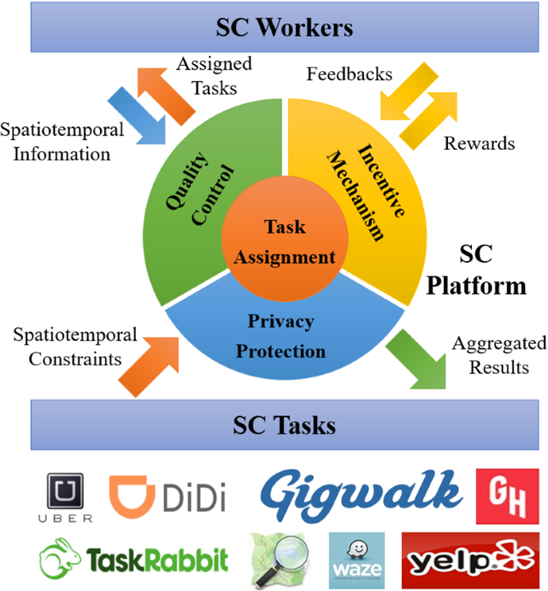
Project Description
Spatial Crowdsourcing
Mobile Application
Algorithm Design

Slide 4
Functional Requirements
Take input of workers, skills, and locations
Take input of job sites and their tasks
Optimize a schedule based on input
Re-optimize schedule based on new time constraints
Alert workers and job sites of schedule

Slide 5
Non-Functional Requirements
Reliability
Security
Performance
Maintainability
Scalability

Slide 6
Engineering Standards
AGILE Development plan
Development is completed on time per our / the customers' schedule
Testing performed using a black-box system

Slide 7
Constraints
Must run as a mobile or desktop application
Map API
Project must not exceed provided budget ($TBD)
Project must be completed within the given time frame

